Slide 1
Hotel Reviews Booking.com
Reviews for an hotel in Larnaca-Cyprus
mid bootcamp project - IronHack
Laurens Heemskerk

Slide 2


About the hotel

Slide 3
Introduction
Dataset
Limitations
What can we learn from our guests’ reviews?
9’s and 10’s matter!

Slide 4
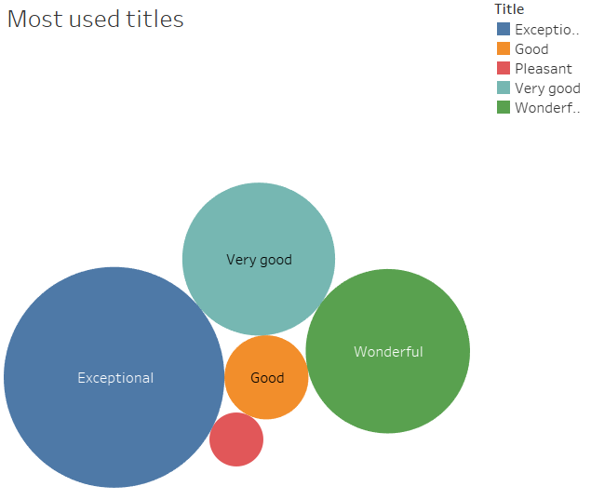
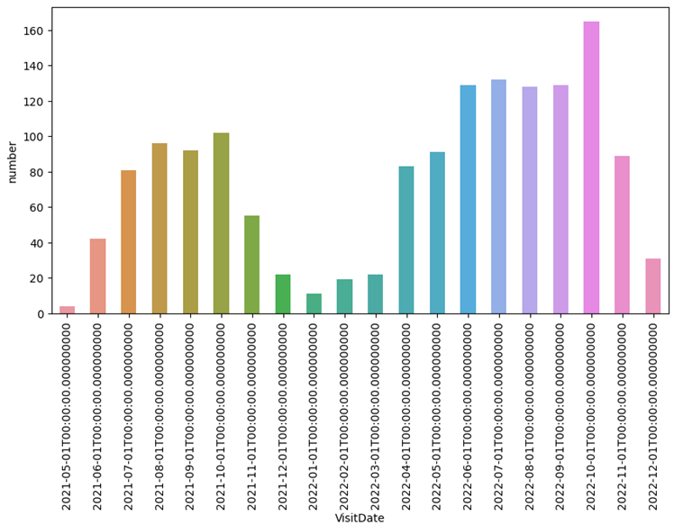
Just some interesting insights about our customers…

Slide 5
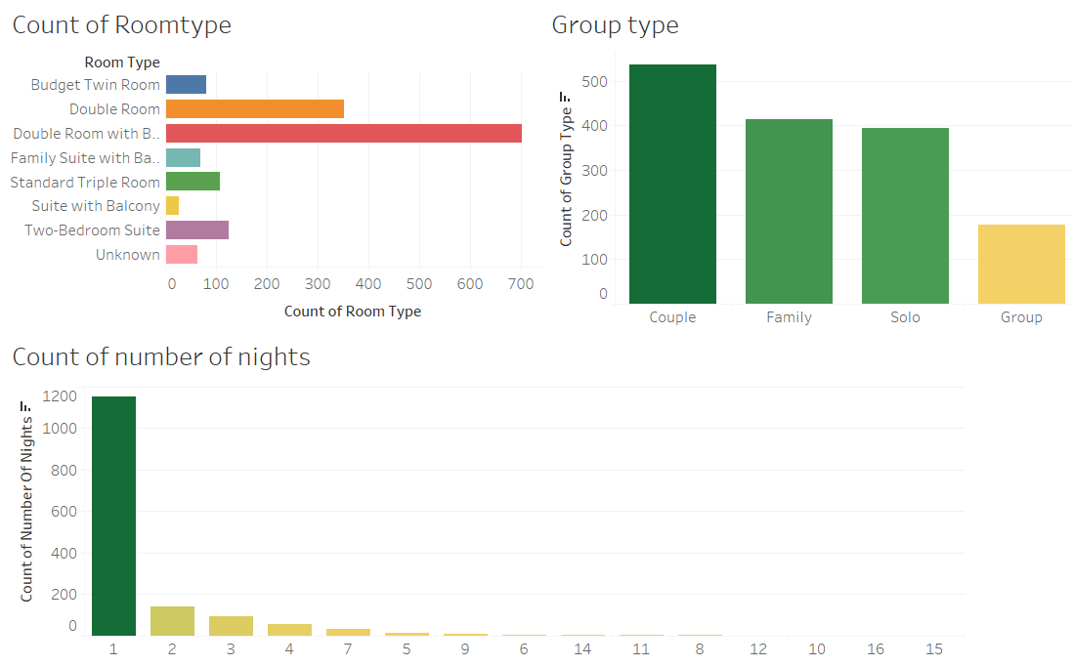

Slide 6
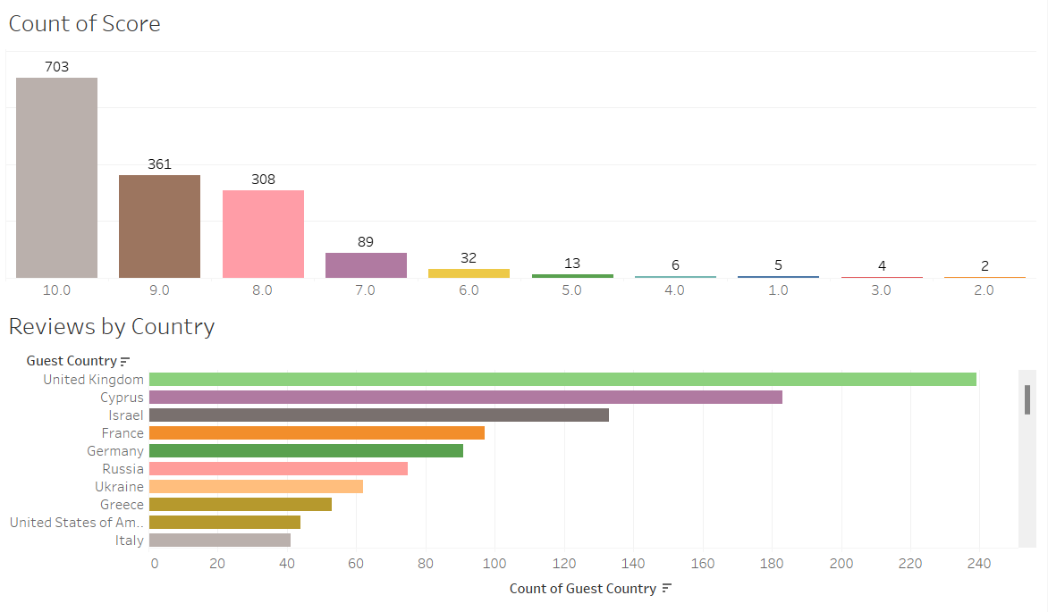

Slide 7
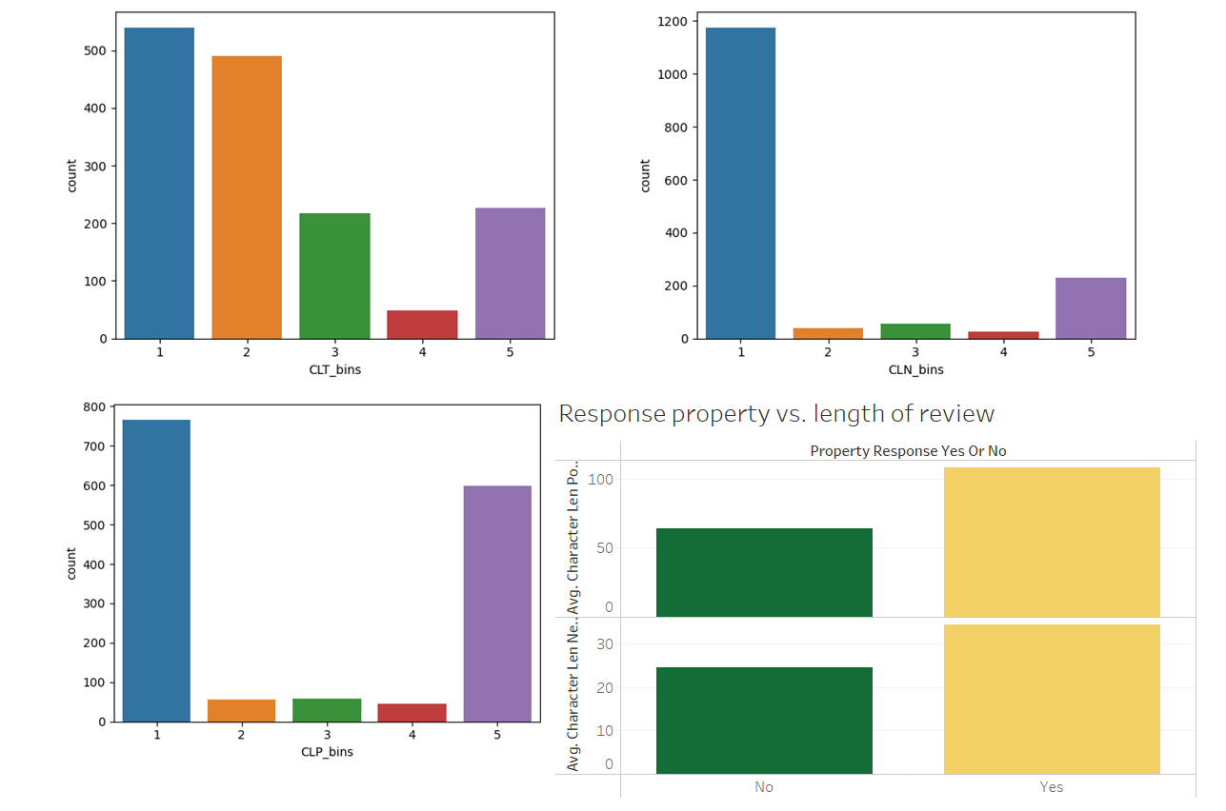

Slide 8
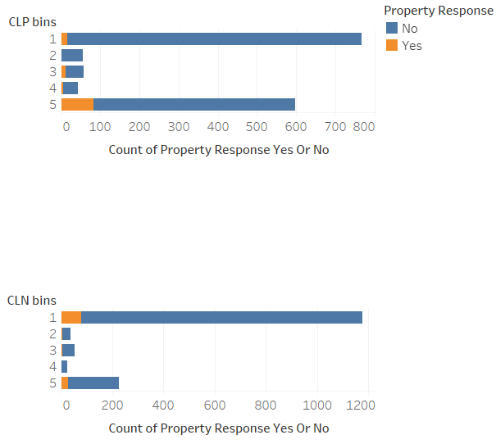

Slide 9
Take away, please!
There is no relationship between the guests’ country and the score they give (chi square)
Positive reviews and negative reviews do not contain the same amount of characters. Positive reviews contain more characters. (two tailed test)
No response for almost 90% reviews

Slide 10
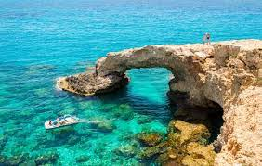
Thank you!

